Slide 1


FOUNDERS: JASON GARCIA | PAOLA CARVAJAL | PRATEEK SHARMA | JASMINE TENGSICO | SRINI GODA

Slide 2

DISCLAIMER
The following idea/concept is based on hypothetical situation, and this is a capstone college project to verify the skills of students in Machine Learning & Blockchain Technologies. Hereby, all the contributors of this project as a student DO NOT support the COIN: “VIXCOIN” in any form of payment method. VIXCOIN doesn’t contain any monetary value in any form. The content presented/mentioned in these slides are for education purpose only & it’s NOT A FINANCIAL ADVICE to consider this Token “VIXCOIN” to invest in any form or even to promote by any means.
Ether/Wei used in this project are FAKE, in order to test the capabilities of this project contributors have used the replica of Ether in test instance (Kovan Testnet). It is NOT a Mainnet network (production) therefore, please do not consider any of these ether as real ones

Slide 3





MEET THE TEAM
PAOLA CARVAJAL
FINANCIAL DATA SCIENTIST |
ML/AI PROGRAMMER
JASON GARCIA
LEAD DEVELOPER |
BLOCKCHAIN DEVELOPER
PRATEEK SHARMA
PRODUCT OWNER |
BLOCKCHAIN ENGINEER
SRINI GODA
SMART CONTRACT DEVELOPER |
BLOCKCHAIN DEVELOPER
JASMINE TENGSICO
PROJECT MANAGER |
BLOCKCHAIN DEVELOPER

Slide 4

OUR COMPANY
VIXCOIN, 1st DeFi SOLUTION TO INVEST
LONG-TERM IN VOLATILITY!!
We are a hybrid DeFi/CeFi company that developed the VIXCOIN token on the Ethereum blockchain
VIXCOIN offers a way to diversify investors’ portfolios during market downturns
VIXCOIN allows investors worldwide to invest in volatility
VIXCOIN derives its value from the performance of our algorithmic trading strategy
Areas we focus in:
| ASSET MGMT. | FINANCIAL ANALYSIS
| ALGORITHMIC TRADING | SMART CONTRACTS

Slide 5
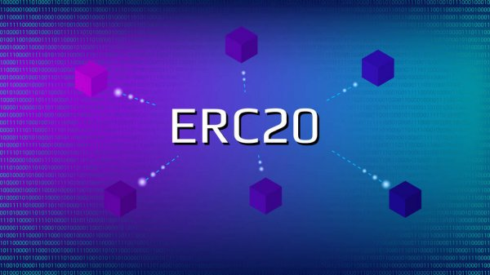
HOW DOES IT WORK??
FROM TOKEN TO INVESTMENT
Users can purchase a token that acts like security on a long-term volatility instrument. Using our algorithmic trading strategy when there are buy and sell signals, we take our users cash and invest it in VIXM.
Notes:
So what do we do as a company? What product and service do we provide in order to address that market need?
VIXCOIN the best way to invest in volatility
Currently, there are financial products that only citizens within the US are able to invest in. In order to level the playing field and create opportunities for global consumers, we are devising a way to help those consumers invest using tokens, smart contracts, and the blockchain infrastructure on Ethereum.
We will choose an investment vehicle and implement an algorithmic trading strategy for it. For example, daily trade on good days of the VIXM which is an exchange traded note (ETN) that tracks the VIX short-term futures. The strategy is defined using Machine learning, and its cumulative return will provide the price of the token. Part of this project includes choosing the best instrument (or mix of instruments) to invest in the VIX. Other alternatives to VIXM are VXZ, and VXX.
In summary, we are selling a token on blockchain that represents an investment on the VIX.
We are a blockchain based asset and financial management service company. We aim to create a token that will allow investors worldwide to invest in VIXM and other financial products that have been limited to only US investors. Consumers will purchase a token from our company using their own currency and our smart contract will use a ML enhanced algorithm to invest the money and sell in order to generate a profit. The VIXM is volatile so investments will be short-term, similar to day trading.

Slide 6
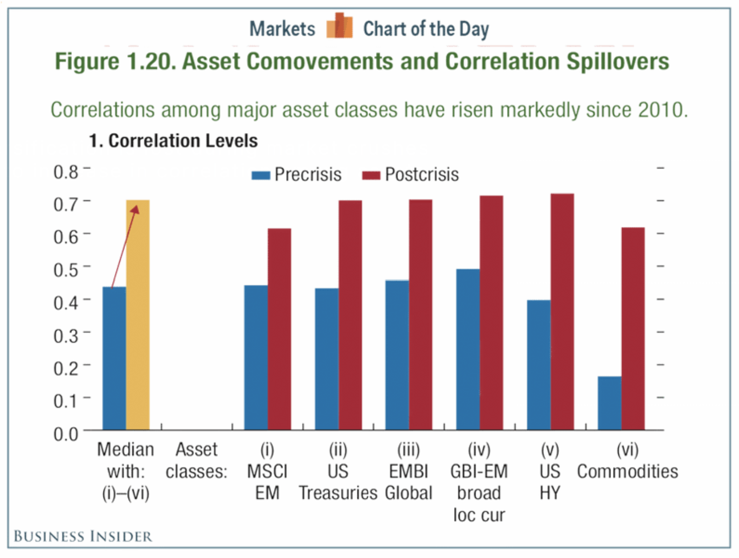
OUR MOTIVATION
- KEY TAKEAWAYS -
ALL ASSET CLASS PRICES ARE LOW
VOLATILITY IS TOO HIGH
INVESTOR’S CONFIDENCE IS LOW
ECONOMIC DEPRESSION
MARKET TRENDS: PRE-CRISIS vs POST-CRISIS
POST-CRISIS PRICE TRENDS IN YEAR 2010
ASSETS
COMMODITIES
US TREASURIES
GLOBAL MARKET
WE
INVEST IN:
VOLATILITY
INDEX FUND

Slide 7
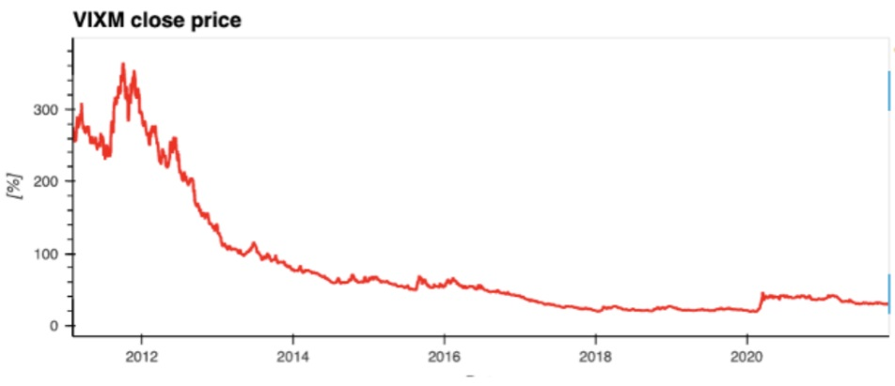
RISKS INVOLVED
WITH AMATEUR INVESTING!!
WARNING!!
Current Volatility Investment Vehicles (VIXM & VXX)
are NOT recommended
for Long-Term Investments.
PROBLEM
WITH
VIXM INDEX
“PRICE DECAY” CAUSED
BY TIME ROLLING!!
CONCLUSION: HIGHLY RISKY
VIXM Closing Price
(2012-2021)
INVESTING IN VIXM
FOR LONG – TERM
IS A RISKY DEAL!!
HENCE, REQUIRED PROFESSIONALS.

Slide 8


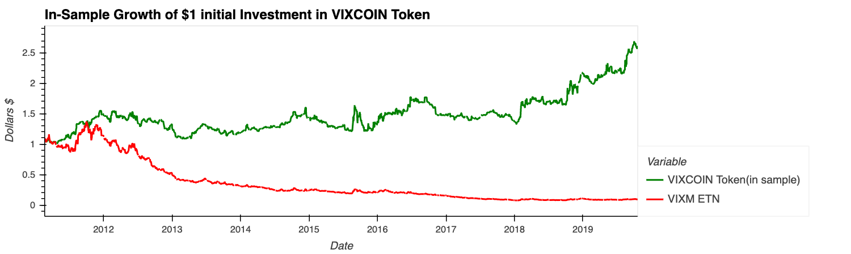
LONG LIVE
THE SAVIOR!!
MORE RETURNS IN LONG-TERM
VIXCOIN REDUCES THE RISK
ML ALGORITHM ELIMINATES THE “PRICE DECAY”
KING OF
VOLATILITY
VIXCOIN vs VIXM
VIXCOIN Closing Price
VIXM Closing Price

Slide 9




SECRET BEHIND THIS MAGIC!!
HIGHLY ADVANCED
MACHINE LEARNING ALGORITHMS
$
REVERSE
DECAY
$
Notes:
So what do we do as a company? What product and service do we provide in order to address that market need?
VIXCOIN the best way to invest in volatility
Currently, there are financial products that only citizens within the US are able to invest in. In order to level the playing field and create opportunities for global consumers, we are devising a way to help those consumers invest using tokens, smart contracts, and the blockchain infrastructure on Ethereum.
We will choose an investment vehicle and implement an algorithmic trading strategy for it. For example, daily trade on good days of the VIXM which is an exchange traded note (ETN) that tracks the VIX short-term futures. The strategy is defined using Machine learning, and its cumulative return will provide the price of the token. Part of this project includes choosing the best instrument (or mix of instruments) to invest in the VIX. Other alternatives to VIXM are VXZ, and VXX.
In summary, we are selling a token on blockchain that represents an investment on the VIX.
We are a blockchain based asset and financial management service company. We aim to create a token that will allow investors worldwide to invest in VIXM and other financial products that have been limited to only US investors. Consumers will purchase a token from our company using their own currency and our smart contract will use a ML enhanced algorithm to invest the money and sell in order to generate a profit. The VIXM is volatile so investments will be short-term, similar to day trading.

Slide 10
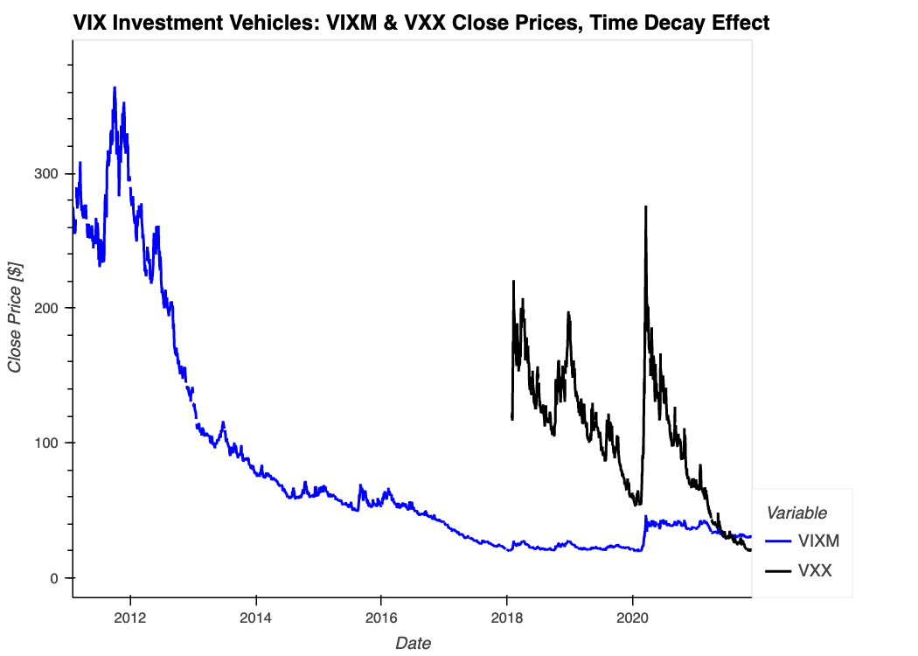
DAILY TRADING STRATEGY
POPULAR VIX INVESTMENT VEHICLES:
VIXM & VXX CLOSING PRICES,
REFLECTING “PRICE DECAY” EFFECT.
VXX
VIXM
DAILY INVESTMENT STRATEGY
+
AVOID!!
-
INVEST!!
CUSTOMIZED
Notes:
So what do we do as a company? What product and service do we provide in order to address that market need?
VIXCOIN the best way to invest in volatility
Currently, there are financial products that only citizens within the US are able to invest in. In order to level the playing field and create opportunities for global consumers, we are devising a way to help those consumers invest using tokens, smart contracts, and the blockchain infrastructure on Ethereum.
We will choose an investment vehicle and implement an algorithmic trading strategy for it. For example, daily trade on good days of the VIXM which is an exchange traded note (ETN) that tracks the VIX short-term futures. The strategy is defined using Machine learning, and its cumulative return will provide the price of the token. Part of this project includes choosing the best instrument (or mix of instruments) to invest in the VIX. Other alternatives to VIXM are VXZ, and VXX.
In summary, we are selling a token on blockchain that represents an investment on the VIX.
We are a blockchain based asset and financial management service company. We aim to create a token that will allow investors worldwide to invest in VIXM and other financial products that have been limited to only US investors. Consumers will purchase a token from our company using their own currency and our smart contract will use a ML enhanced algorithm to invest the money and sell in order to generate a profit. The VIXM is volatile so investments will be short-term, similar to day trading.

Slide 11
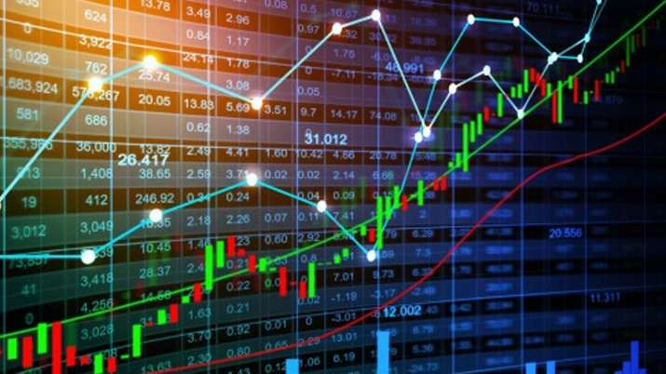
DAILY
SIGNALS
STRATEGY EXECUTION
SECURITIES & INDEXES
INVEST
1
DON’T
INVEST
0
Model Tuning
Volume
Model Training
Return Squared
ADABOOST ML Model
Returns
Volatility
+
Month & Day of Week
-
PCA
PREDICTING
SIGN FOR
NEXT DAY RETURN
FEATURES CALCULATION
CUSTOMIZED
Notes:
So what do we do as a company? What product and service do we provide in order to address that market need?
VIXCOIN the best way to invest in volatility
Currently, there are financial products that only citizens within the US are able to invest in. In order to level the playing field and create opportunities for global consumers, we are devising a way to help those consumers invest using tokens, smart contracts, and the blockchain infrastructure on Ethereum.
We will choose an investment vehicle and implement an algorithmic trading strategy for it. For example, daily trade on good days of the VIXM which is an exchange traded note (ETN) that tracks the VIX short-term futures. The strategy is defined using Machine learning, and its cumulative return will provide the price of the token. Part of this project includes choosing the best instrument (or mix of instruments) to invest in the VIX. Other alternatives to VIXM are VXZ, and VXX.
In summary, we are selling a token on blockchain that represents an investment on the VIX.
We are a blockchain based asset and financial management service company. We aim to create a token that will allow investors worldwide to invest in VIXM and other financial products that have been limited to only US investors. Consumers will purchase a token from our company using their own currency and our smart contract will use a ML enhanced algorithm to invest the money and sell in order to generate a profit. The VIXM is volatile so investments will be short-term, similar to day trading.

Slide 12
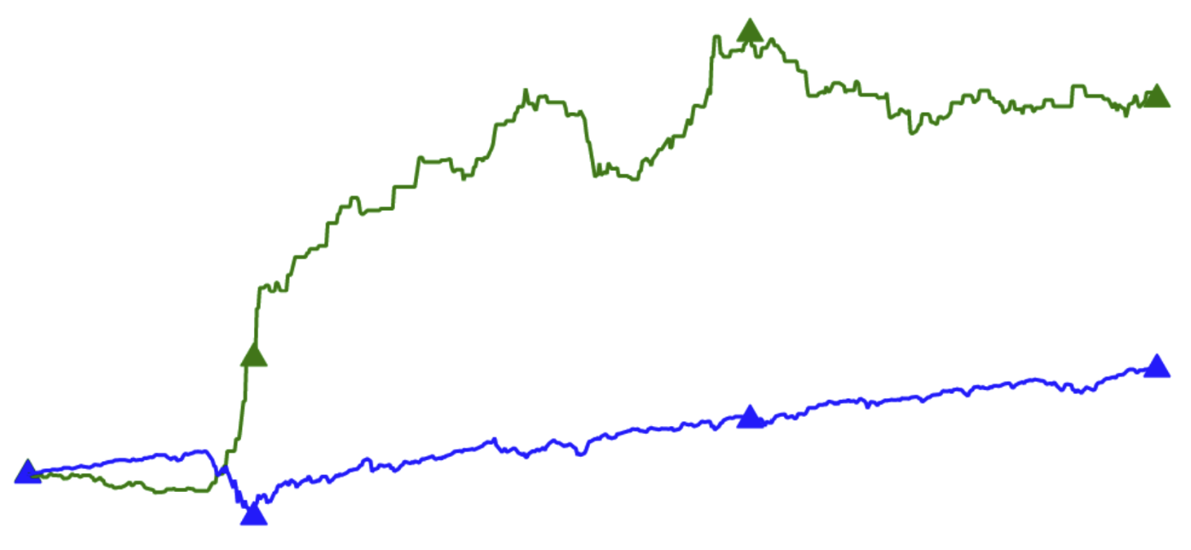
$$ TOKEN VALUATION CONCEPT $$
VIXCOIN
$2.50
HIGHER
RETURNS
BETTER THAN
S&P 500 ETF!!
VIXCOIN
Loves DIPS!!
VIXCOIN Valuation Derives from Market Volatility!!
$1.60
SPY ETF
$1
01/2020
05/2020
09/2020
01/2021
05/2021
09/2021
COMPARISON WITH S&P 500 ETF: If, VIXCOIN Token Pricing initiated in Oct 2019.
Notes:
The price of the VIXCOIN corresponds to the growth of $1 dollar invested at the moment of the sell of the first token

Slide 13

SMART CONTRACT
Our smart contract is the connection between the digital token, the trading strategy, and the user interface (website).
It offers users:
Decentralization
Trustless
Proof of investment
Security

Slide 14
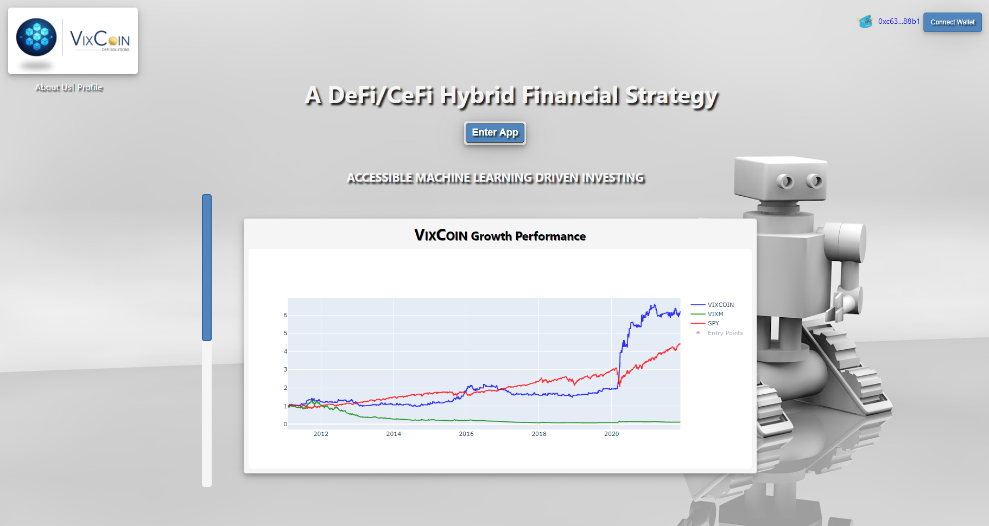
UI DEMO

Slide 15
NEXT STEPS
ENHANCEMENTS
LEGAL
PRICING
Bridge between VIXCOIN
Token and VIXM Investment.
Professional Fee based on
Trading Strategy Performance.
SEC and FCC Compliance.

Slide 16

THANKS FOR BEING WITH US!!
- FINTECH PROJECT -
Notes:
Jas- its the only pi

